Slide 1
Bank Management System
Ayush Yelne (63),
Vikas Yadav (62),
Pranav Satam (38),
Manav Modi (08)
Date of presentation: 14/12/2020
Under the guidance of: Prof. Anushree Patkar
Atharva College of Engineering
Department of Information Technology

Slide 2
Content
1. Introduction
1.1 Introduction
1.2 Motivation
1.3 Problem Statement
1.4 Objectives
2. Literature Survey
2.1 Survey of Existing system
2.2 Limitation Existing system or research gap
2.3 Mini Project contribution
3. Proposed System
3.1 Architecture/Framework
3.2 Algorithm and Process Design
3.3 Software Requirement Specification
3.4 Implementation Code
3.5 Output Screenshots
4. Conclusion
5. Future work
References
ACE- IT department Bank Management System

Slide 3


1) Introduction
1.1 Introduction
A bank is a financial institution which accepts deposits, pays interest on pre-defined rates, clears checks, makes loans, and often acts as an intermediary in financial transactions. It also provides other financial services to its customers.
ACE- IT department Bank Management System

Slide 4


1.2 Motivation
To develop a system that will overlook the activities going transaction the particular bank without manual processing. All transaction will be updated automatically by using the information stored in record. The main motive behind this project is to develop a system which will able to handle the overall tasks going inside the institutions without much effort.
ACE- IT department Bank Management System

Slide 5
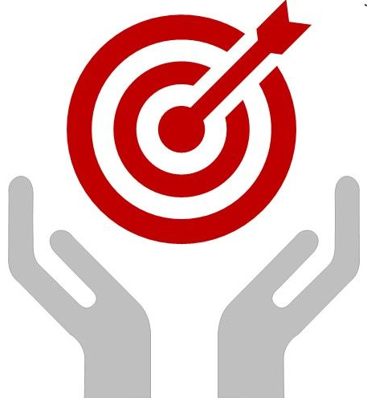
1.3 Problem Statement
Although the basic type of services offered by a bank depends upon the type of bank and the country, services provided usually include: Taking deposits from their customers and issuing current or checking accounts and savings accounts to individuals and business. Extending loans to individuals and business, Cashing cheque. Facilitating money transactions such as wire transfer and cashiers cheque, Consumer & commercial financial advisory services, financial transaction can be performed through many different channels.
ACE- IT department Bank Management System

Slide 6


1.4 Objectives
To allow only authorized user to access various function and processed available in the system.
Locate any A/C wanted by the user.
Reduced clerical work as most of the work done by computer.
Provide greater speed & reduced time consumption
ACE- IT department Bank Management System

Slide 7

2) Literature Survey
2.1 Survey of Existing system
To deposit or withdraw money from bank one has to stand in long queues.
The staff members has to enter details of the customer manually
Banks only work on specific days and specific time.
ACE- IT department Bank Management System

Slide 8

2.2 Limitation Existing system or research gap
Insufficient branches
Lot of employees are required
People who go for their job don’t get time to visit banks as the working time of the bank is limited
ACE- IT department Bank Management System

Slide 9


2.3 Mini Project contribution
All the process will be automated thus reducing manual work
No need to worry of timings as this will be available anytime
Creating a new account will be easy by just sitting at your home
All the data will be stored safely without having the risk of losing it
ACE- IT department Bank Management System

Slide 10

3) Proposed System
3.1 Architecture/Framework
Banking management system is a software build to carry out basic functions of a bank easily
It will help the admin to keep a track on the data of customers digitally without any manual work
This system will keep records of existing users, his details, transactions and many more things
Using this software customer can easily perform transactions like withdrawal of money, checking his balance, etc.
ACE- IT department Bank Management System

Slide 11
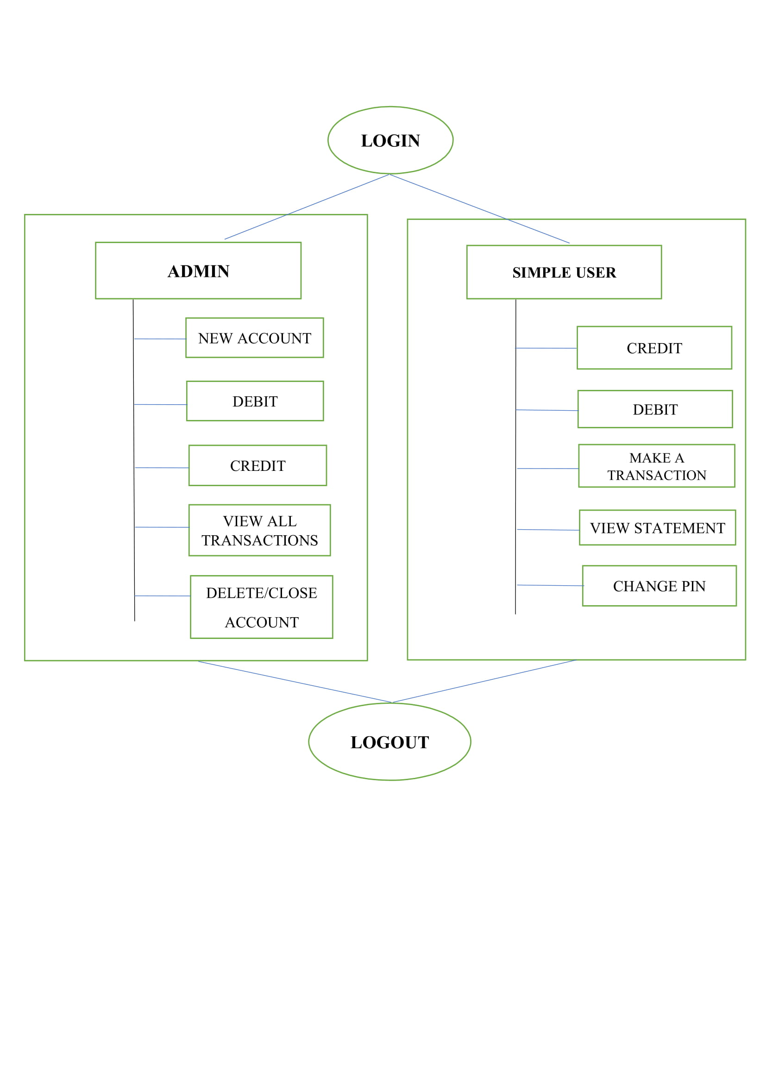
3.2 Algorithm and Process Design
ACE- IT department Bank Management System

Slide 12
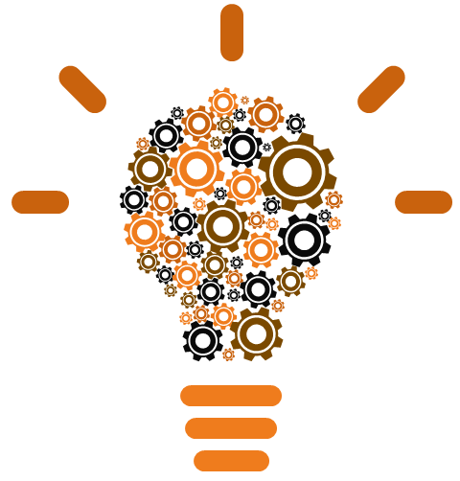
3.3 Software Requirement Specification
Language - Java (core)
Concept - Swing
IDE - Netbeans
Database - MySQL using Wamp server
ACE- IT department Bank Management System

Slide 13
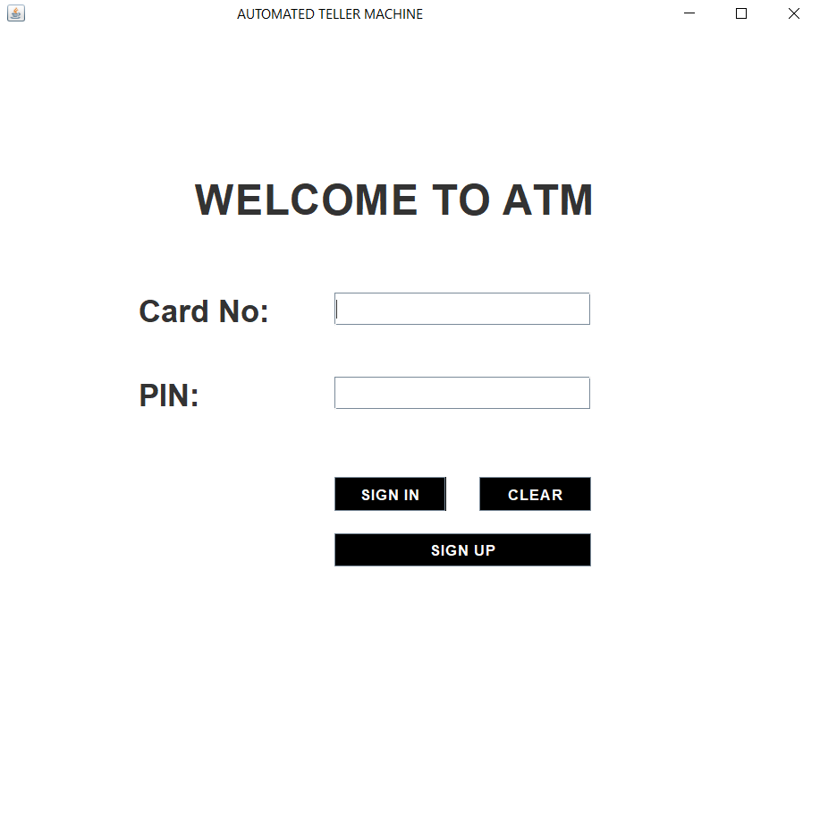
3.5 Output Screenshots:
Login page:
ACE- IT department Bank Management System

Slide 14
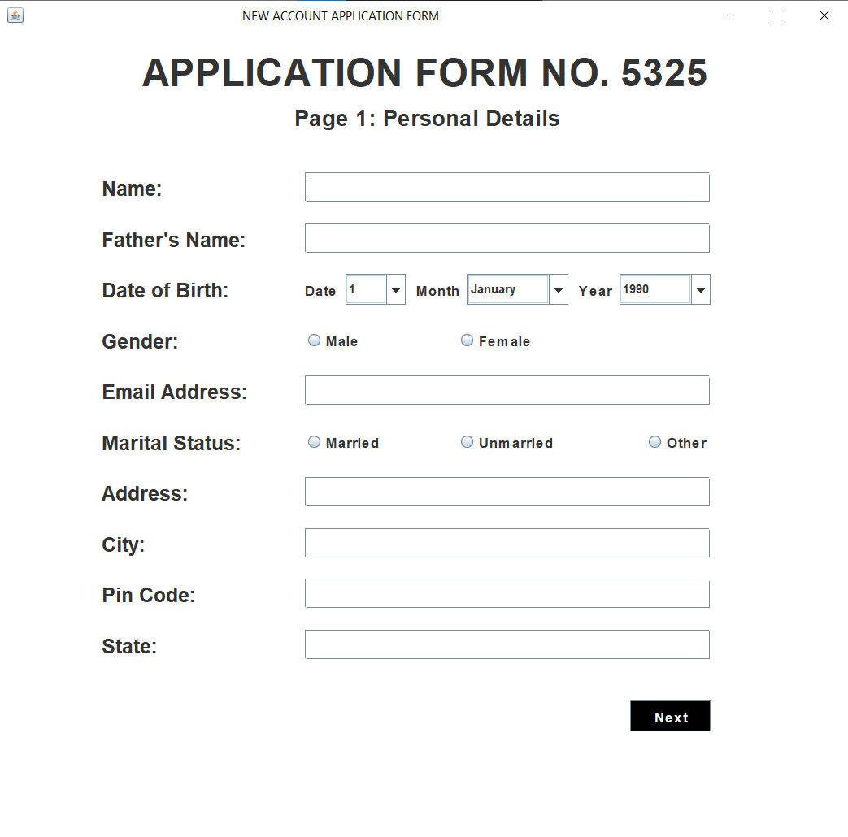
2. Signup Page 1:
ACE- IT department Bank Management System

Slide 15
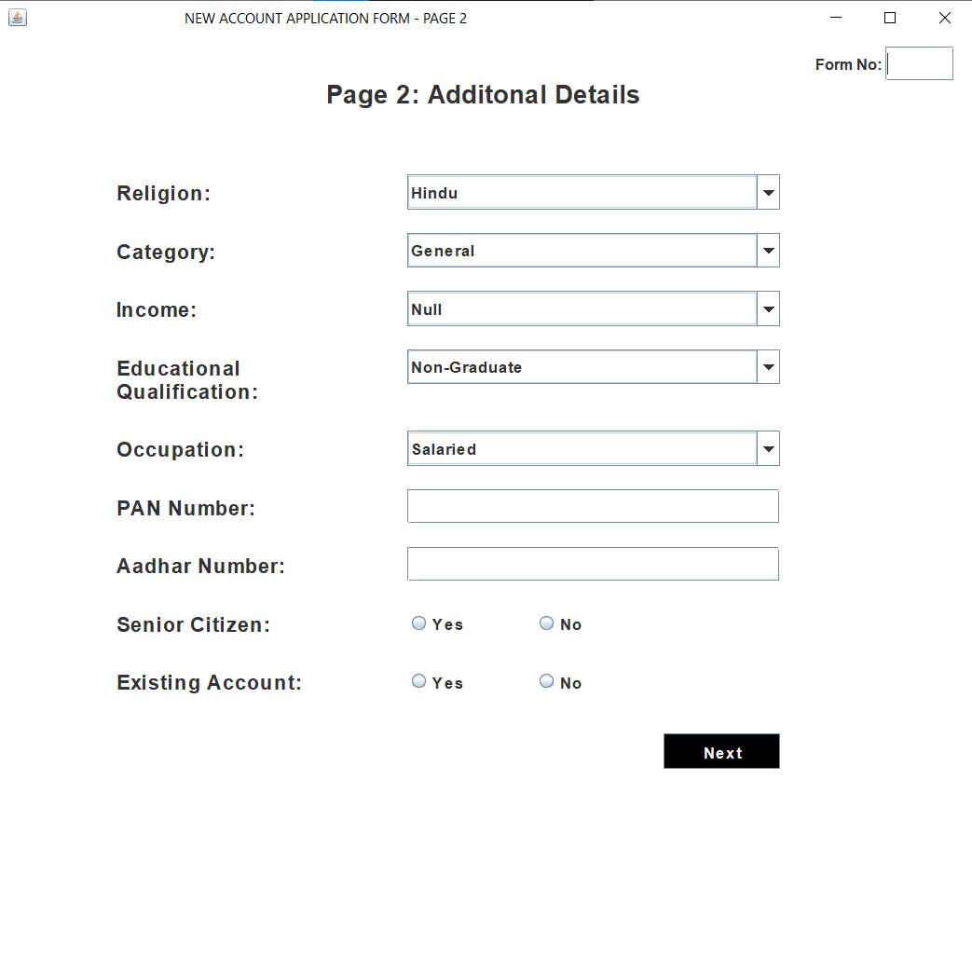
3. Signup Page 2
ACE- IT department Bank Management System

Slide 16
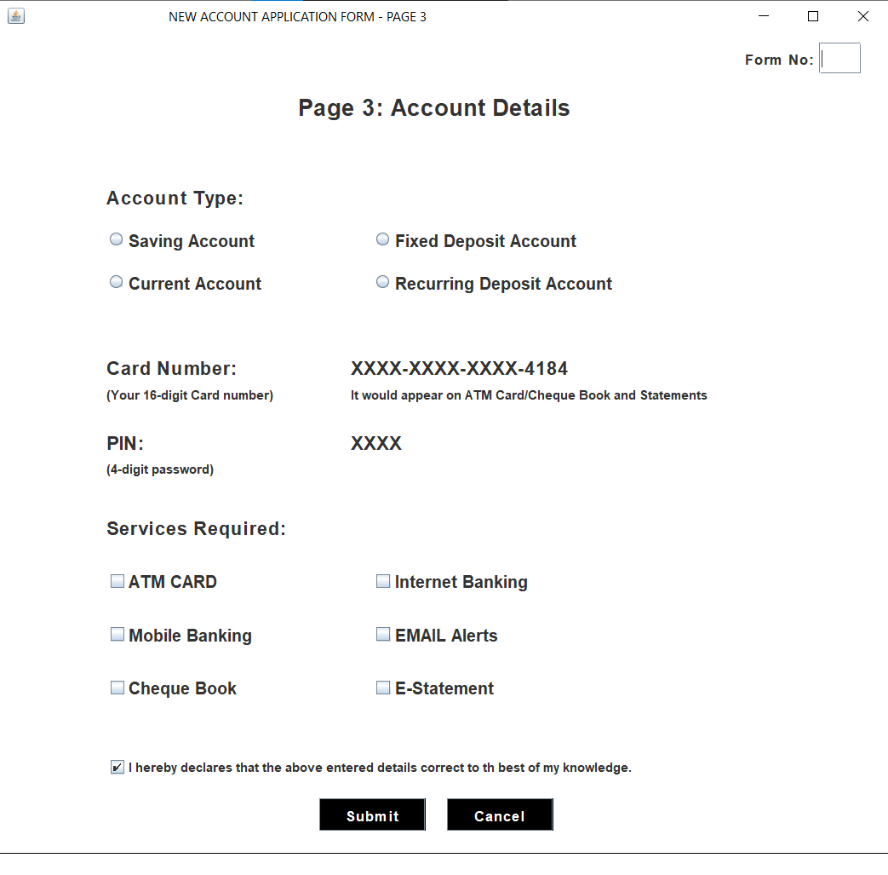
4. Signup Page 3:
ACE- IT department Bank Management System

Slide 17
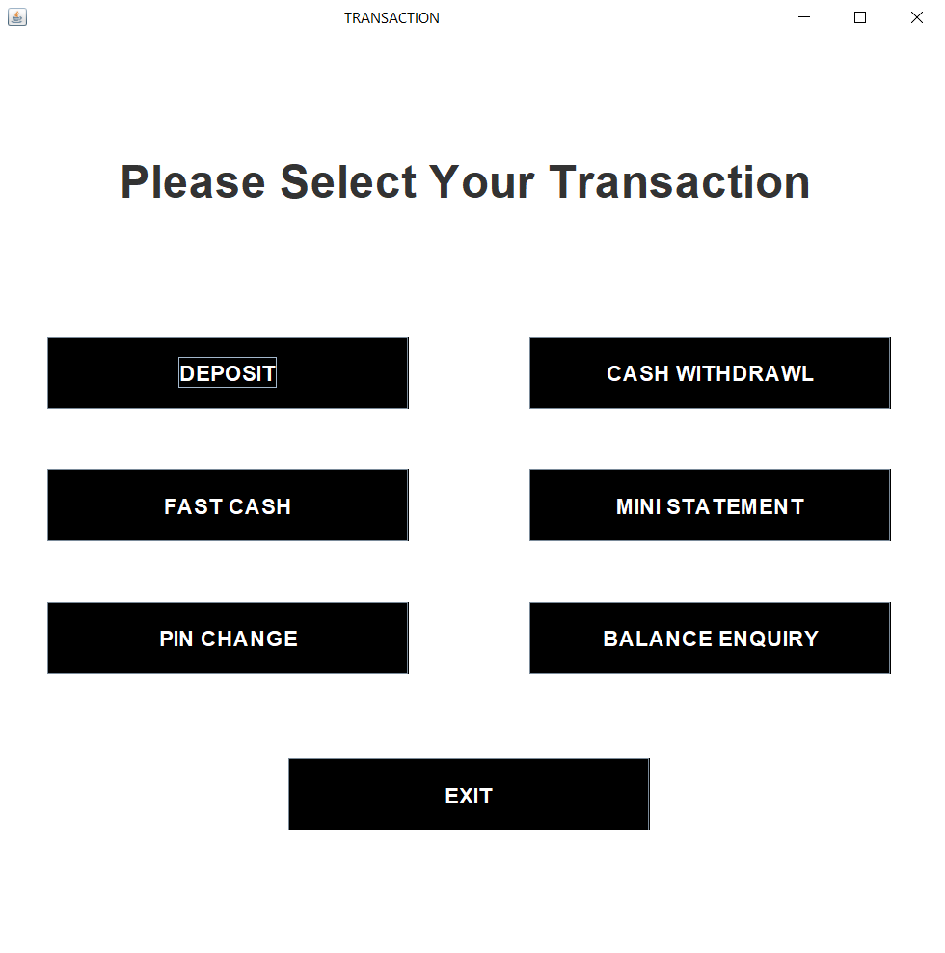
5. Home Page:
ACE- IT department Bank Management System

Slide 18
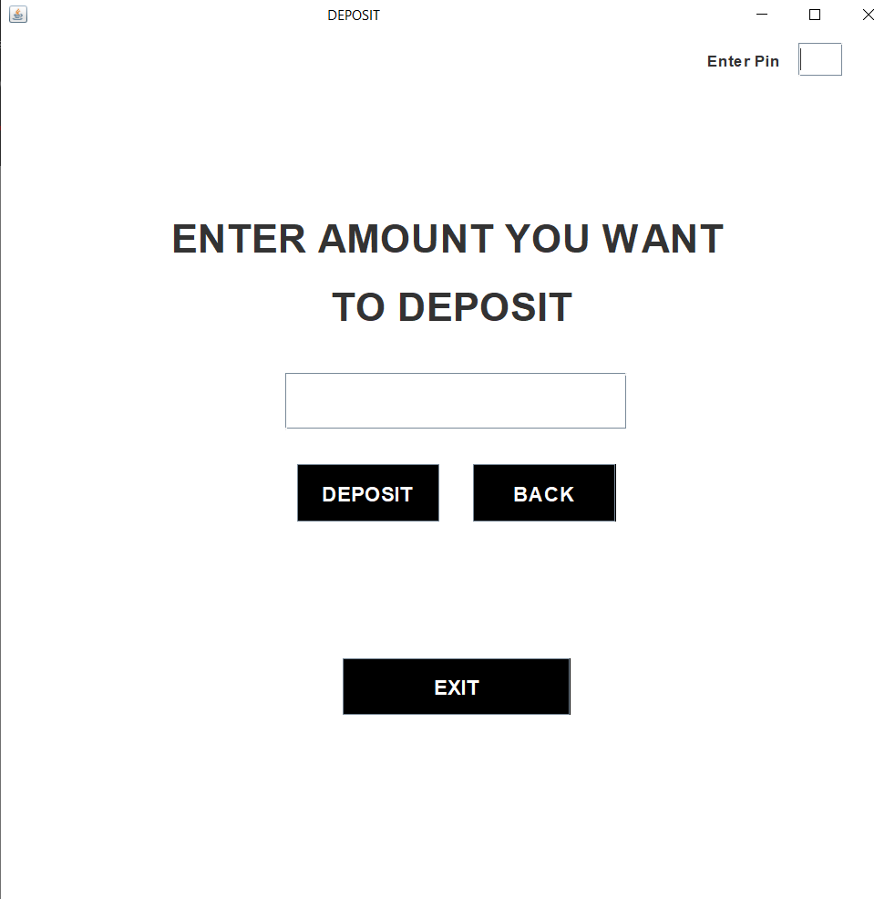
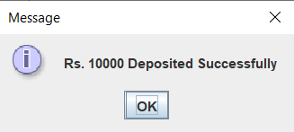
6. Deposit Cash:
ACE- IT department Bank Management System

Slide 19
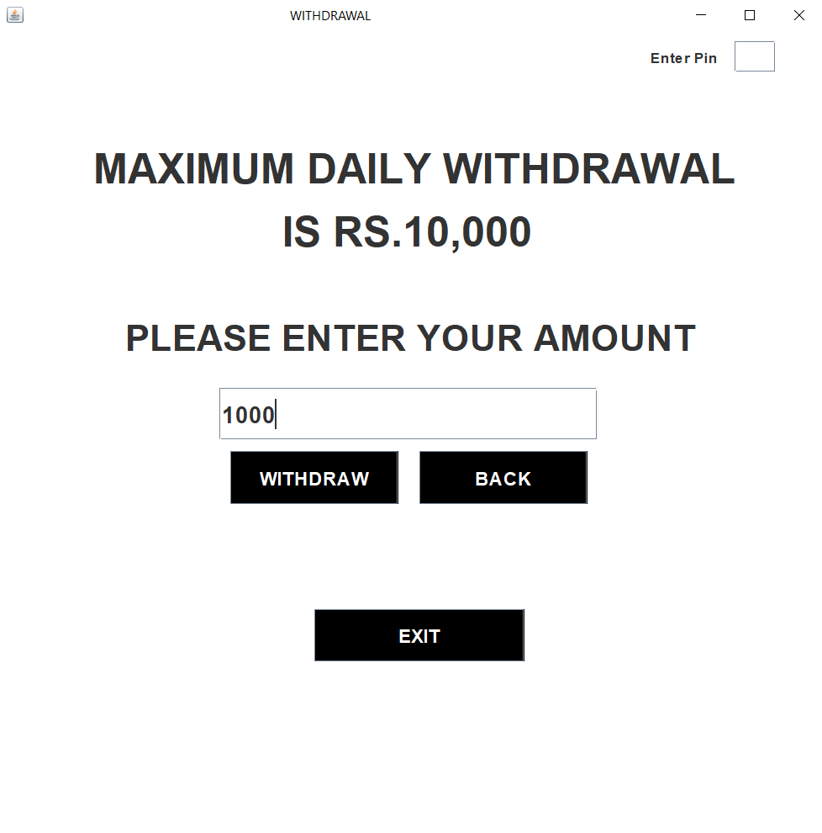
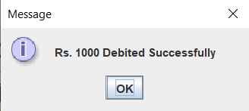
7. Withdraw Cash:
ACE- IT department Bank Management System

Slide 20

4) Conclusion
This project is developed to nurture the needs of a user in a banking sector by embedding all the tasks of transactions taking place in a bank.
The banking system are used manual working but when we used online banking system it is totally virtualization process which avoid manual process and converts it in automatic process
Bank management system is saving the time with accuracy than bank manual system.
ACE- IT department Bank Management System

Slide 21

5) Future Work
Adding SMS feature which will send a SMS to the customer when transaction will take place from their account
ACE- IT department Bank Management System

Slide 22


Questions ??
Thank You !!!!
ACE- IT department Bank Management System

